Slide 1


An Investigation into the Contribution of Locally Aggregated Descriptors to Figurative Language Identification
Sina Mahdipour Saravani ¹, Ritwik Banerjee², Indrakshi Ray¹
¹Colorado State University
²Stony Brook University

Slide 2
Backgrounds
Vector of Locally Aggregated Descriptors (VLAD) and NeXtVLAD

Slide 3
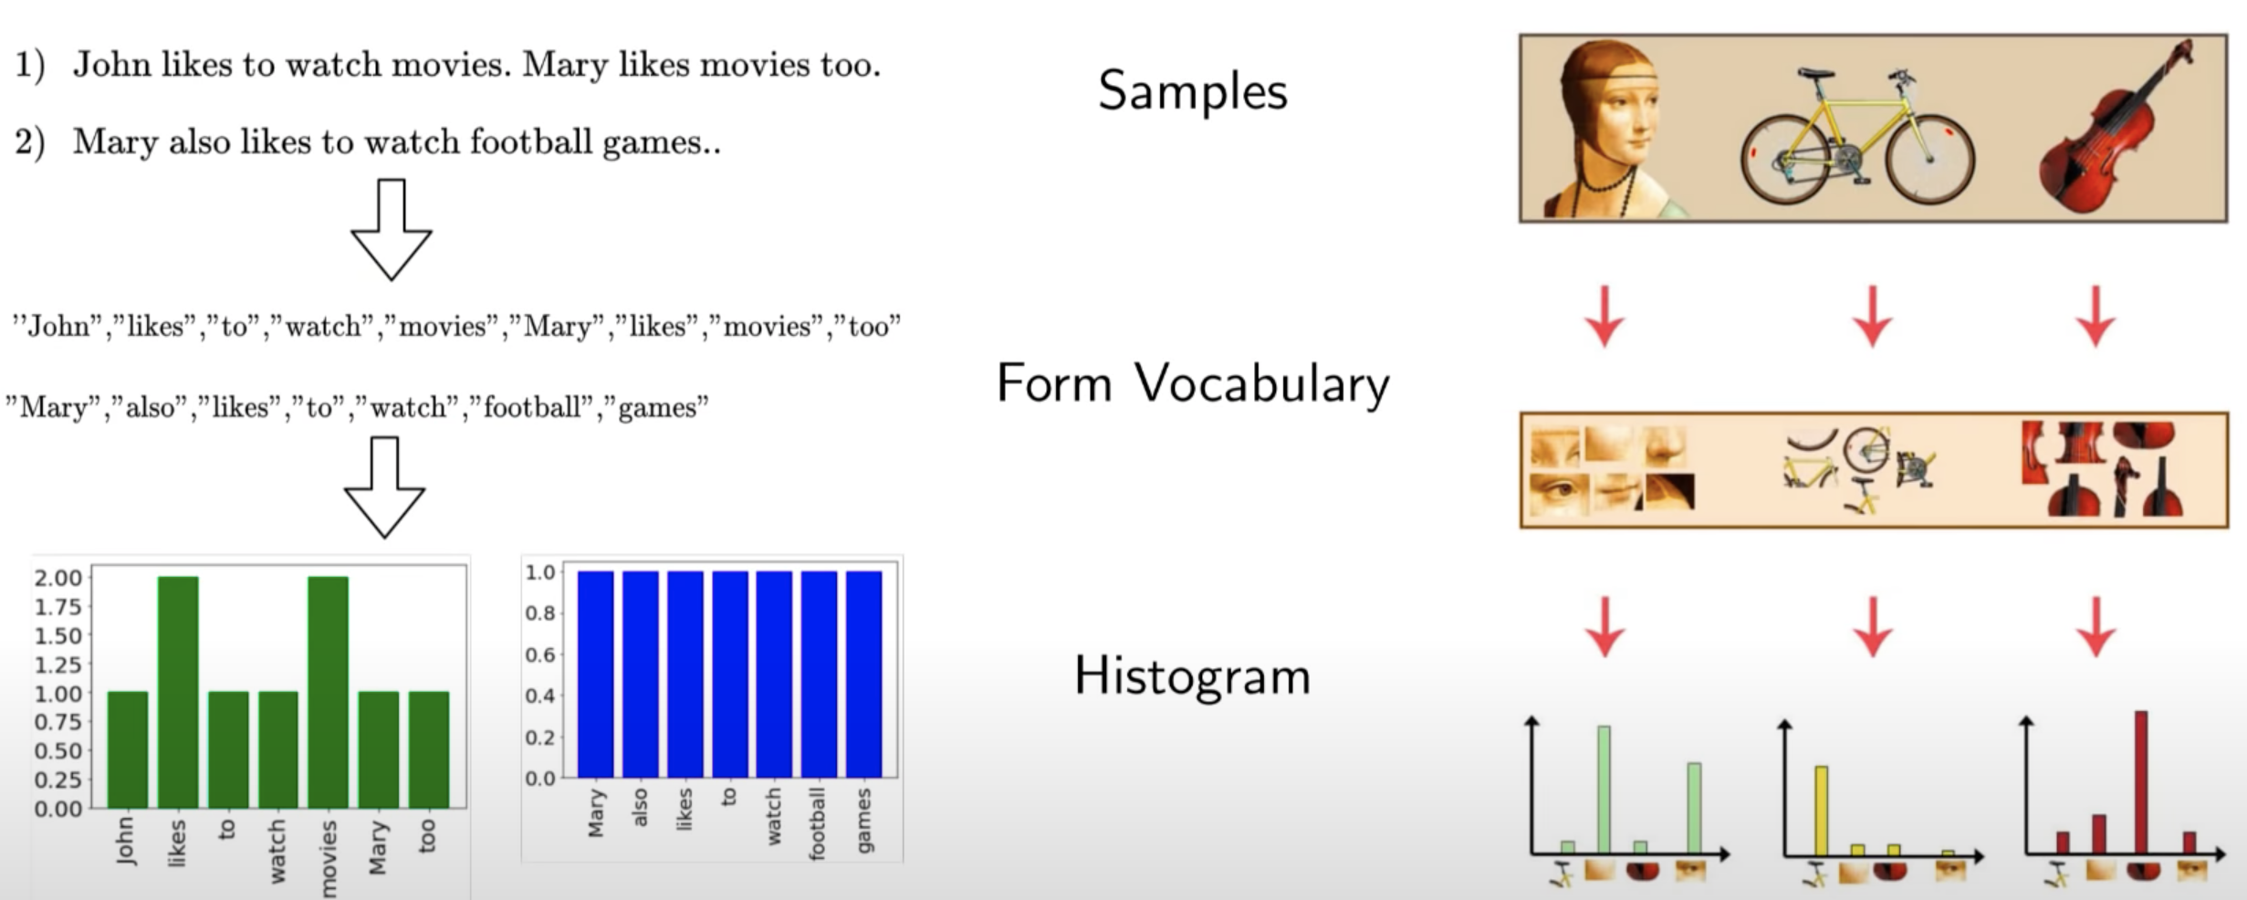
Bag of Visual Words
Vineeth N Balasubramanian, https://www.youtube.com/watch?v=CwJPEMcuAxY
Notes:
Maybe SIFT descriptors or just segmentation of the original image

Slide 4
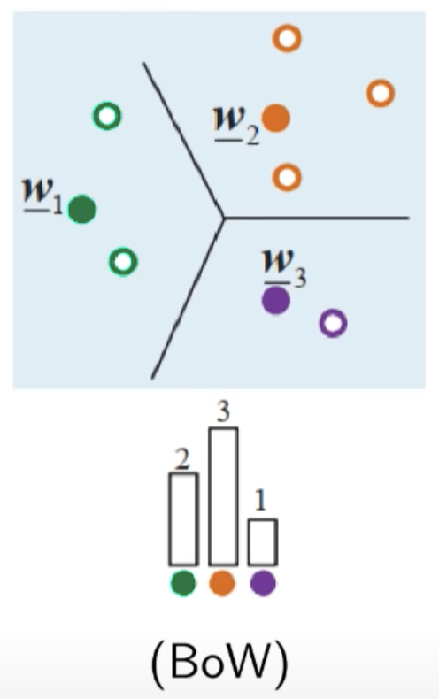
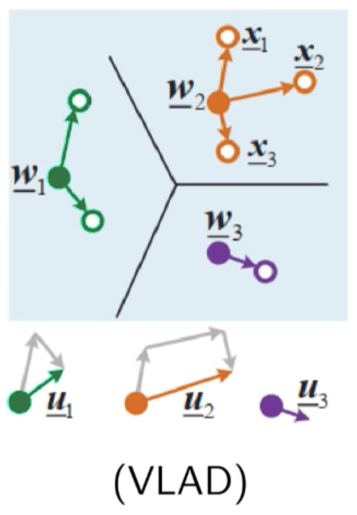
VLAD
Vector of Locally Aggregated Descriptors
Built on top of Bag of Visual Words
Difference vector instead of presence frequency
Considering K clusters of all features
Vineeth N Balasubramanian, https://www.youtube.com/watch?v=CwJPEMcuAxY
Notes:
BoW output: K * 1
VLAD output: K * N (sift dimension)

Slide 5
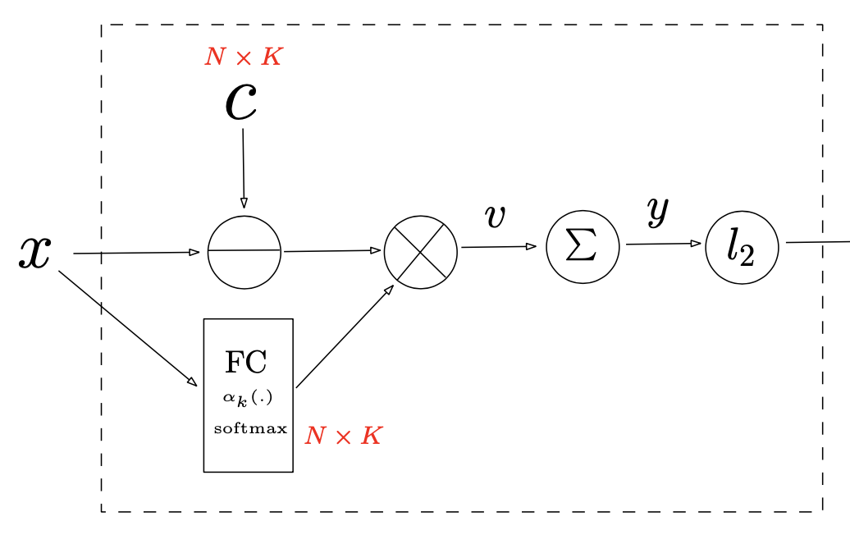
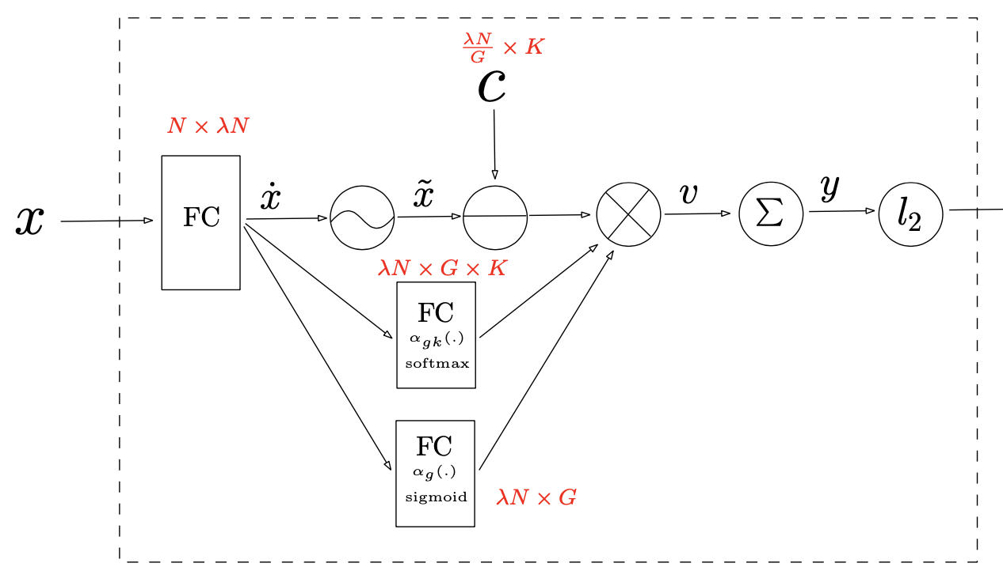
NetVLAD & NeXtVLAD
NetVLAD
NeXtVLAD
Lin, Rongcheng, Jing Xiao, and Jianping Fan. 2018. NeXtVLAD: An Efficient Neural Network to Aggregate Frame-level Features for Large-scale Video Classification. In Proceedings of the European Conference on Computer Vision (ECCV) Workshops, pages 206-218. Springer.

Slide 6
Our Work

Slide 7
Motivation
Increase in popularity of Deep Learning
Decrease in reliability of findings
Figurative language
Ambiguous, context-dependent, and inferential in nature
General difficulty in identification
Unsuitability of shallow syntactic and semantic features for figurative language understanding
Use of Deep Learning as a natural candidate

Slide 8
Motivation
Reliability concerns in Deep Learning
Difficulty of figurative language understanding
It is reasonable NOT to expect outright success only based on the use of a neural network layer

Slide 9
Motivation
Use of augmented pipelines
Gluing multiple sophisticated components together
The interpretability issue beyond reliability:
Which component is responsible for improved outcomes?
How effective is a component of the pipeline for the downstream NLP task?
Such details are sometimes omitted from research papers

Slide 10
Our Task
Investigate the state-of-the-art sarcasm detection pipeline by Lee et al. (2020)
F₁ score = 93.1% (14% higher than the next best results; reported to FigLang2020 workshop)
Perform an ablation study by removing the NeXtVLAD component from their architecture
Introduce a custom CNN architecture to extract features for NeXtVLAD and analyze its performance based on them
Hankyol Lee, Youngjae Yu, and Gunhee Kim. 2020. Augmenting Data for Sarcasm Detection with Unlabeled Conversation Context. In Proceedings of the Workshop on Figurative Language Processing, pages 12–17. Association for Computational Linguistics.

Slide 11
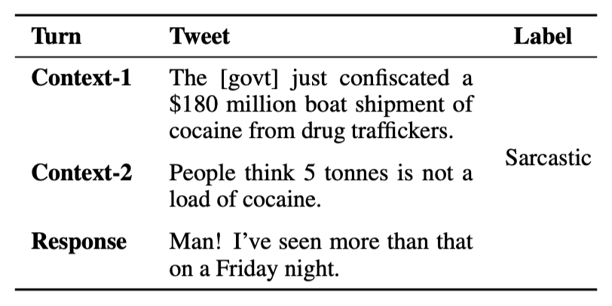
Downstream NLP Task
Determine if the final response in a thread of tweets is sarcastic
Debanjan Ghosh, Avijit Vajpayee, and Smaranda Muresan. 2020. A Report on the 2020 Sarcasm Detection Shared Task. In Proceedings of the Workshop on Figurative Language Processing, pages 1—11. Association for Computational Linguistics.

Slide 12
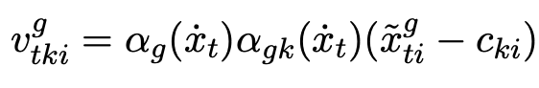
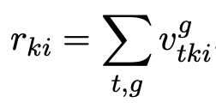
The architecture

Slide 13
Experiments
Use of unpublished additional training data, hyperparameters, and validation set by Lee et al. (2020)
Exact reproduction is impossible
To analyze the contribution of the NeXtVLAD component independently
Perform a comprehensive set of experiments with modifications in architecture, hyperparameters, and data

Slide 14
Experiments
Architecture modifications:
BERT (Base & Large), CTBERT(v1 & v2)
BiLSTM
NeXtVLAD
KimCNN
Our custom CNN
Data modifications:
Labeled augmentation
Data expansion
Hyperparameter modifications:
Num. training epochs
Linear and cyclic LR schedulers with various values
Batch size

Slide 15
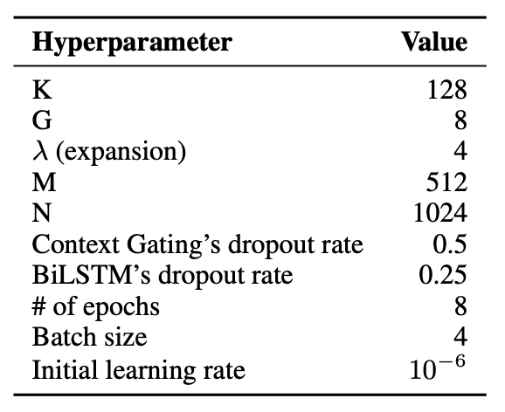
Experiments
For reported experiments in the paper:
Early stopping with delta=0 and patience=2
With fixed random seed
8 training epochs

Slide 16
Experiments
To reduce the differences in shape and quantity of features fed to NeXtVLAD in Computer Vision and NLP
Designed our custom CNN

Slide 17
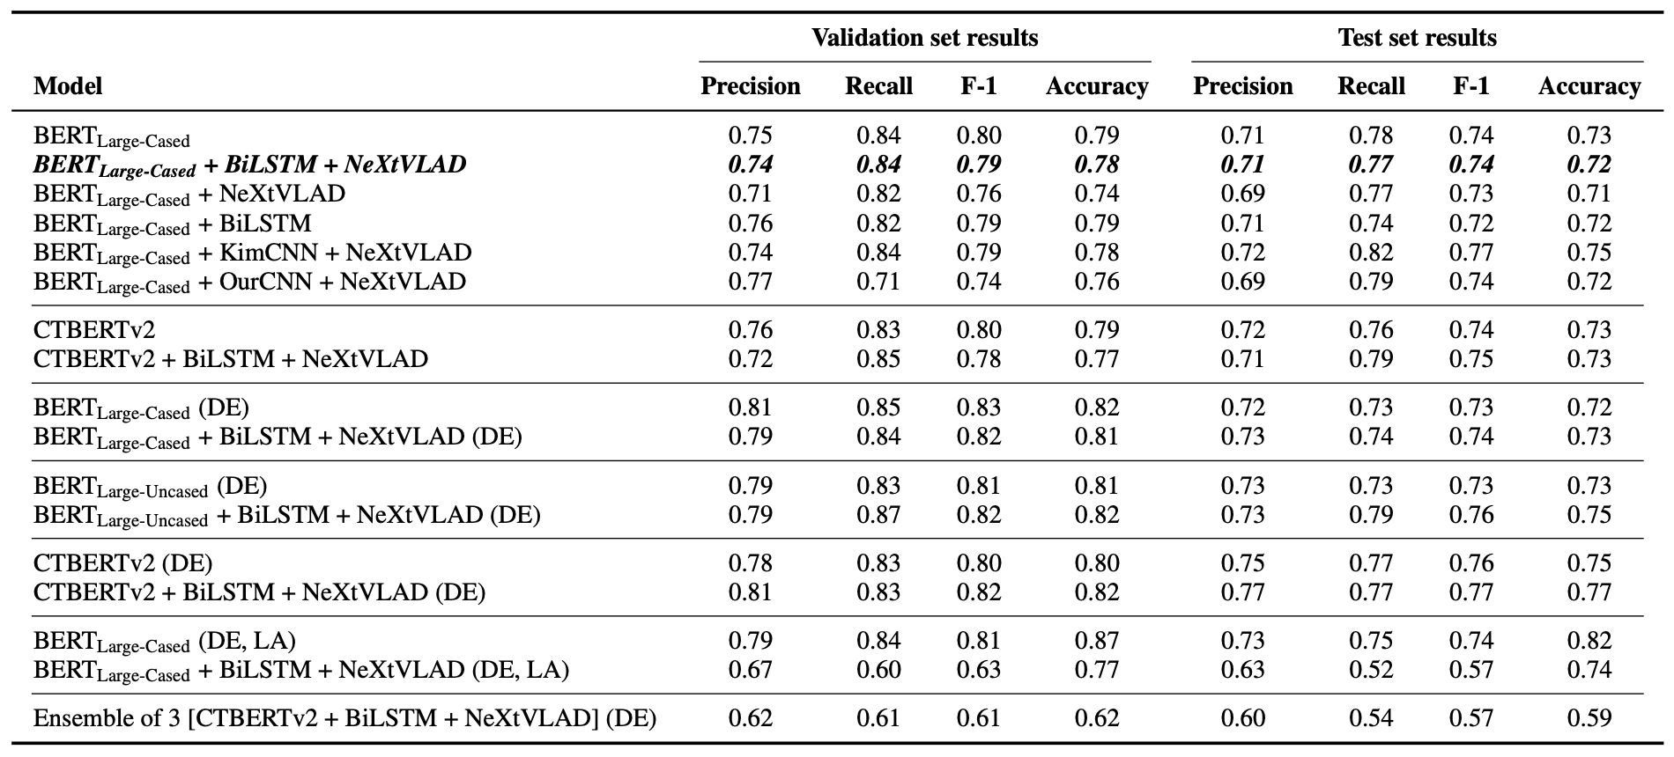
Results

Slide 18
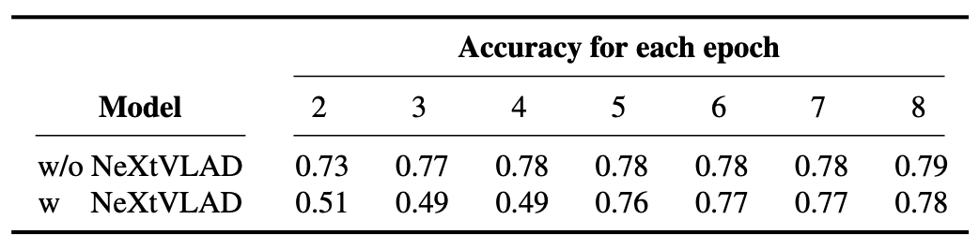
Results
Validation set results with and without NeXtVLAD in each epoch for the first model configuration:
Based on all experiments:
Ablated version of the model w/o NeXtVLAD performs largely equally well.

Slide 19
Discussions and Conclusions
No significant improvement accomplished by incorporation of NeXtVLAD in this sarcasm detection task
The excellent F₁ score of Lee et al. (2020) is
due to the natural language augmentation techniques
and NOT the novel architecture
Local aggregators like NeXtVLAD are unlikely to offer significant benefits to figurative language processing

Slide 20
Discussions and Conclusions
Increase in cost of computation
Environmental impact
Models not fitting on single 12GB GPUs
Unable to train them
Without providing benefits

Slide 21
Questions?
Thanks for your attention!
code/data @ github.com/sinamps/nextvlad-for-nlp
This work was supported in part by funds from U.S. National Science Foundation (NSF) under award number CNS 2027750, CNS 1822118, and SES 1834597, and from NIST, Statnett, Cyber Risk Re- search, AMI, and ARL.

